Slide 1
INDUSTRY X.0
Enterprise Knowledge Language (EKL) & Business Logic (BL)
Pooja Jain

Slide 2

Topic of Content
What is Business Logic (BL)
Spot the right BL using Traces
Enterprise Knowledge Language (EKL)
Access to Data Set Up
Calling CAA from EKL
Calling EKL from CAA

Slide 3
Business Logic
These are the rules and instructions which allows a user to modify the OOTB behavior by adding some custom behavior.
BL can be both client side as well as server side.
BL are managed by two files:
CATRule
CATRuleExit

Slide 4
CATRule and CATRuleExit
The CATRule File contains the Business Logic And CATRuleExit file contains the details of the OpeningID, Type and Name of script file.
Example of CATRuleExit File : MyBLFile.CATRuleExit
<Scripts>
<Script OpeningID=“PLMAttributePropagation" Type=" VPMReference" ScriptName=" MyBLFile.CATRule " />
</Scripts>

Slide 5
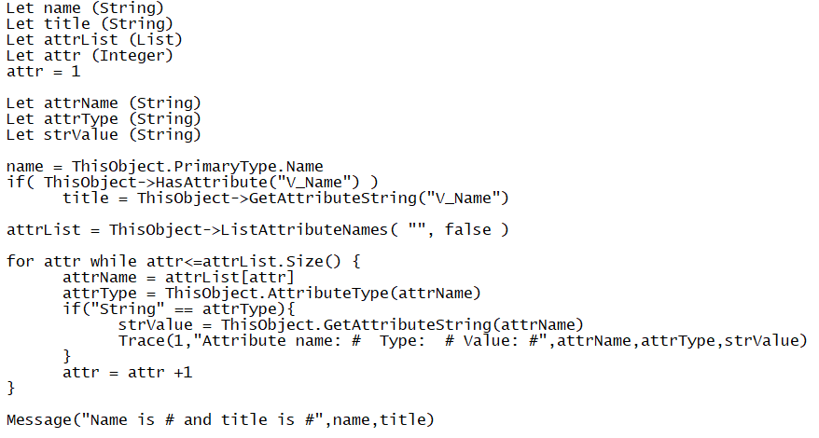
Example of CATRule File: MyBLFile.CATRule

Slide 6
Example of Client-side BL which are mostly used :
PLM Business Logic Implementations
Attributes Valuation Propagation (PLMAttributesPropagation)
Attributes Valuation Check (PLMAttributesValuationCheck)
Instance Aggregation Check (PLMInstanceAggregationCheck)
Import/Export Attributes Valuation (PLMImportExportAttributesValuation)

Slide 7
Example of Server-side BLs :
Pre Check Maturity
Post Check Maturity
PLMMaturityAction
Pre Check Delete
Post Check Delete
Pre Check Create
PLMCreateAction
Pre check Update
PLMUpdateAction
Pre Check Duplicate

Slide 8
Opening ID
An opening ID is an entry point used to customize business logic.
The PLM system is delivered with a set of pre-defined openings for you to integrate its specific processes. The implementation of a PLM Opening is performed through rules. Each PLM Opening is referenced by a unique identifier called as the PLM Opening ID.
For the same opening ID , several business rules can be created, according to the different possible fact types and P&O projects to which the resource sets will be bound. The administrator creates or edits an existing resource table containing the selected opening ID and assigns the created business rules to the different couples <Opening ID> | <Fact Type>. When satisfied with the customization, the administrator deploys his customization on the production server.
Example : PLMAttributesPropagation :To make any attribute editable.

Slide 9
Customization Intent
The PLM system triggers the business rule with a customization intent.
There are three types of intents:
Validation: Used to validate the state of an object, or an action on an object.
Computation: Used to compute a result from the state of an object.
Execution: The object can be modified by the rule.
Reference Link :
https://media.3ds.com/support/documentation/product/V6R2013x/en/English/DSDoc.htm?show=TczUserMap/tcz-m-KnowlLanguage-sb.htm

Slide 10
BL Location
BL Path OOTB : C:\ProgramFiles\DassaultSystemes\B420\win_b64\resources\knowledge\scripts
BL path Custom: - %CUSTO_FOLDER%/win_b64\resources\knowledge\scripts
Points to Remember
/!\Never modify files directly under OOTB folder /!\
Check the OOTB BL before adding a new one
If an OOTB BL already exists, copy/past the OOTB CATRule to you custom folder and your modification at the end.

Slide 11
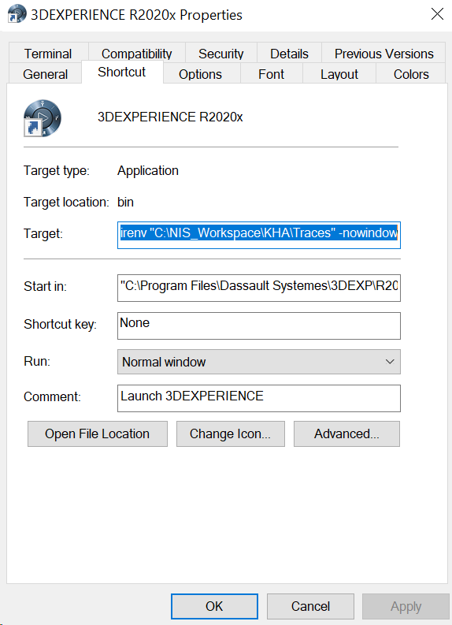
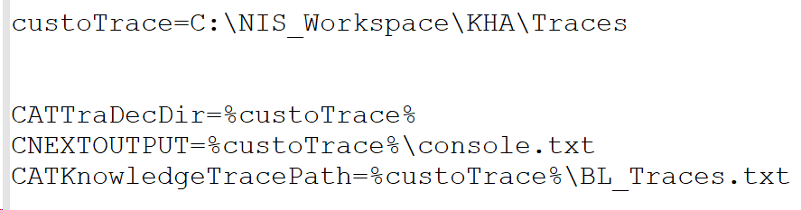
Env File
"C:\Program Files\Dassault Systemes\3DEXP\R2020x\win_b64\code\bin\CATSTART.exe" -run "3DEXPERIENCE" -env env_pooja -direnv "C:\NIS_Workspace\KHA\Traces" –nowindow
"C:\Program Files\Dassault Systemes\3DEXP\R2020X\win_b64\code\bin"

Slide 12
Writing EKL Code
Using EKL Action Command
Using Data Setup Application
Using Know how Component

Slide 13

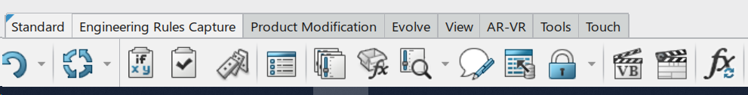
EKL Action
Using Engineering rule Capture application in 3D quadrant. We can create a EKL Action on a particular object

Slide 14
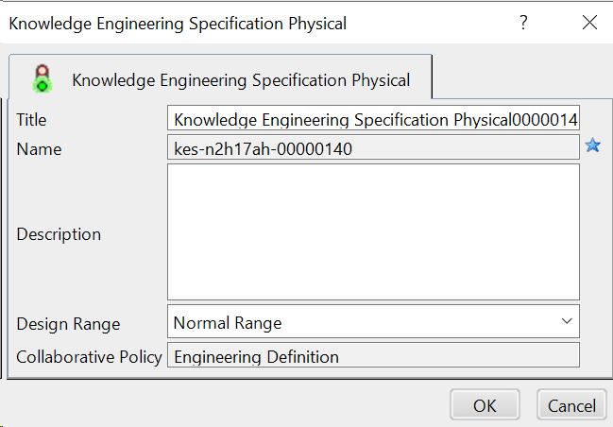
Create EKL Action

Slide 15
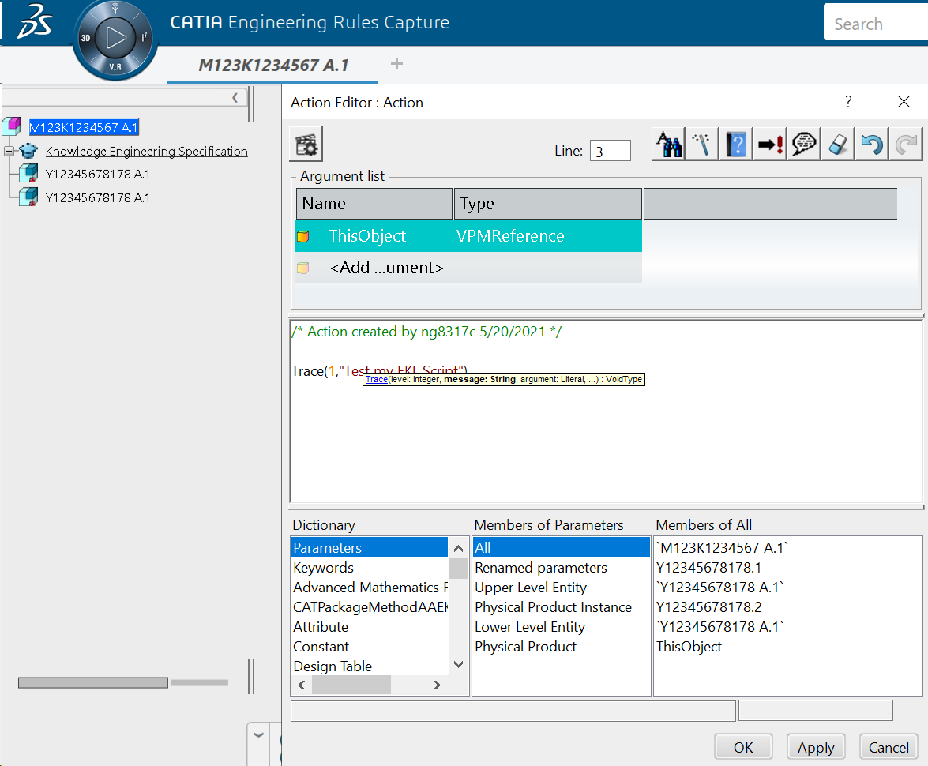
Write EKL Action

Slide 16
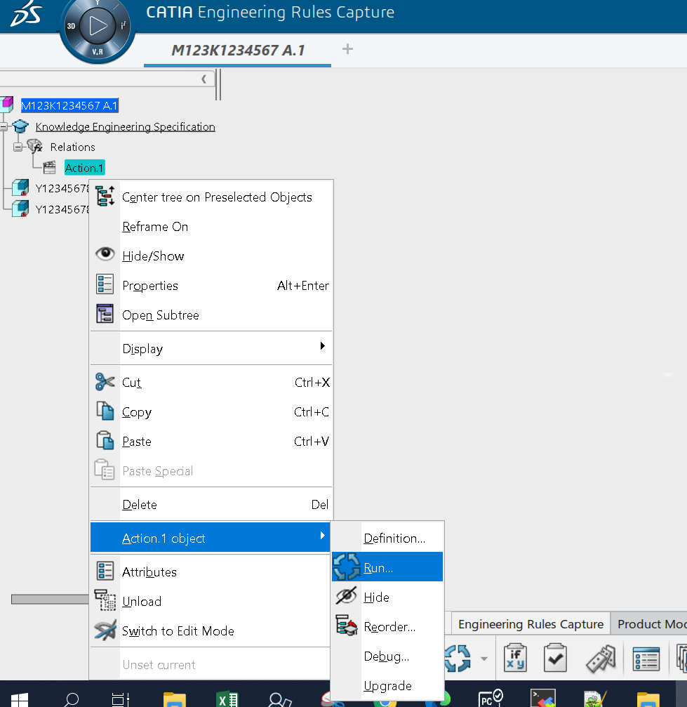
Run EKL Action

Slide 17
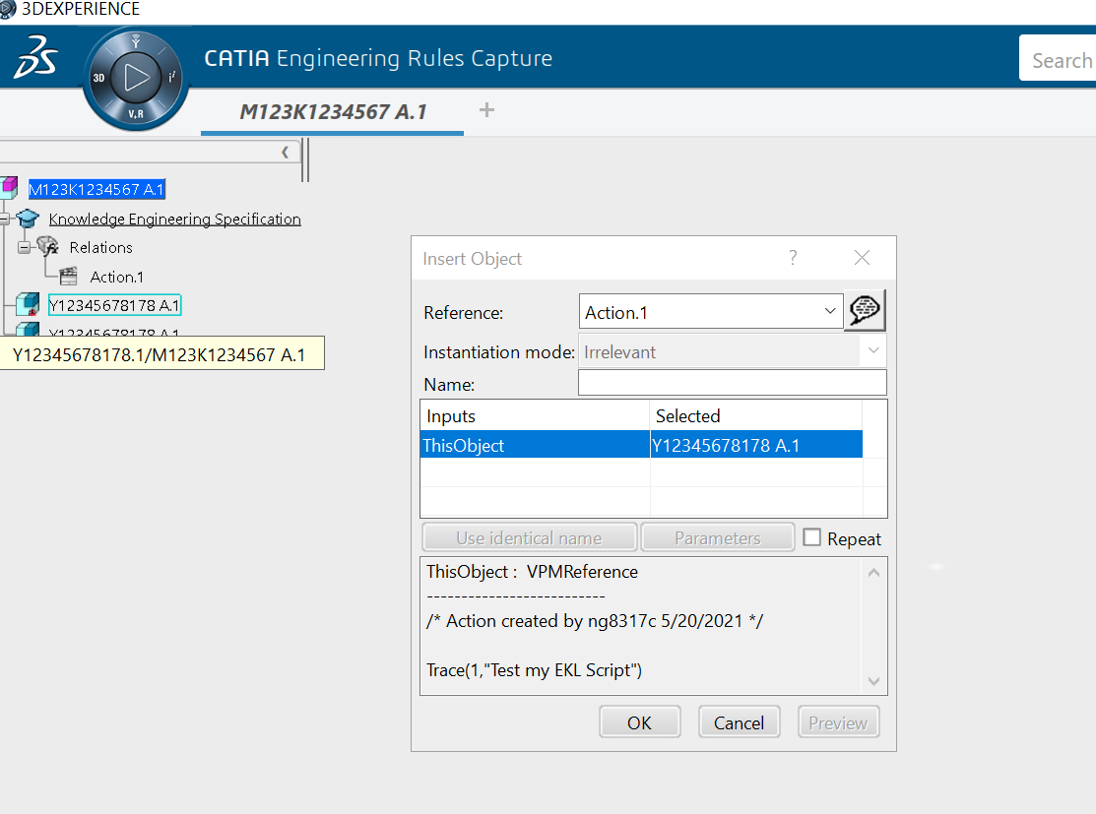
Run EKL Action

Slide 18
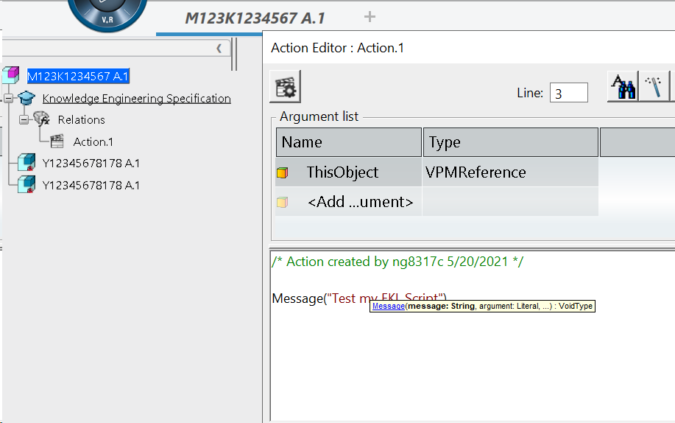
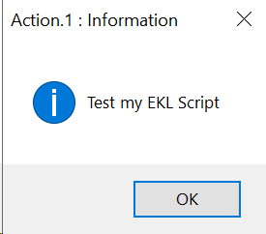
Output

Slide 19
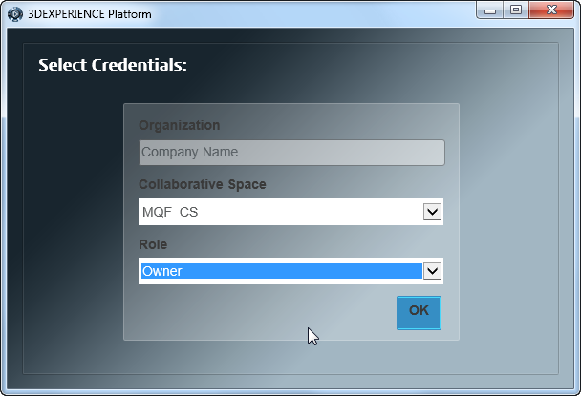

Access To Data Setup
Connect to 3DEXPERIENCE with a user having the 'Owner' role
In the 'My Social and Collaborative Apps' quadrant, click on Data Setup app
2

Slide 20
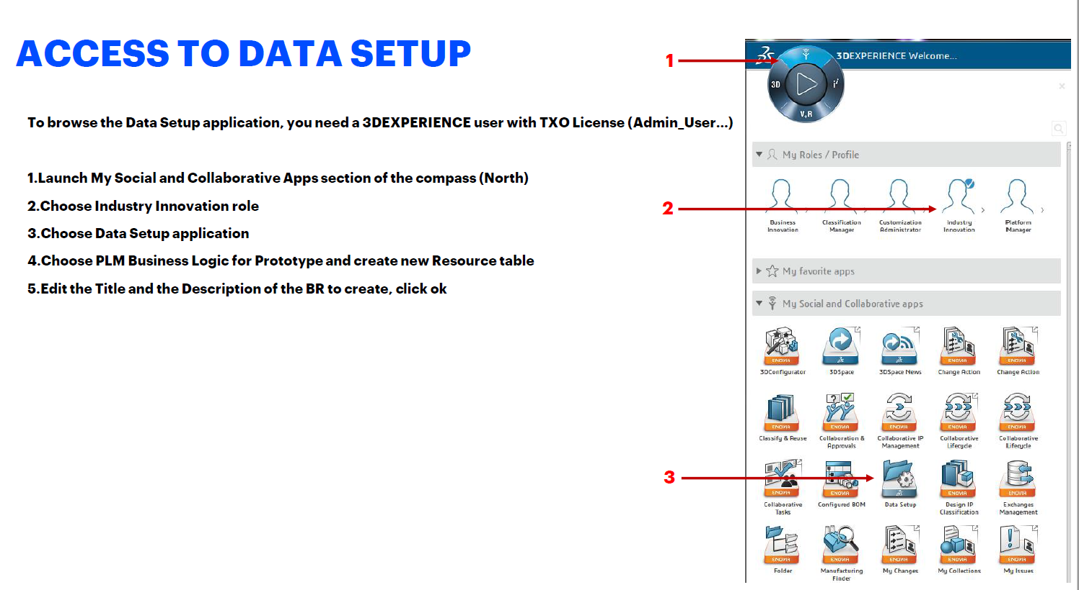
Access To Data Setup

Slide 21
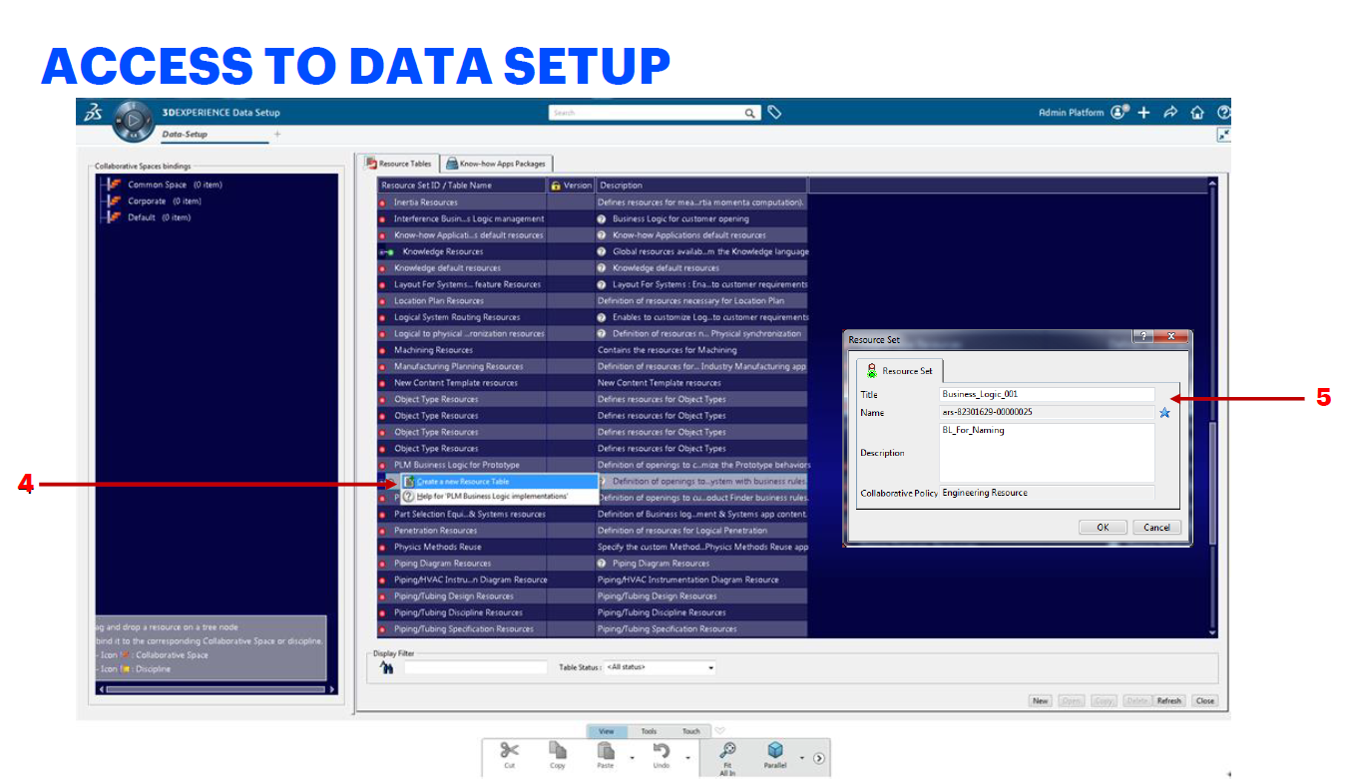

Slide 22
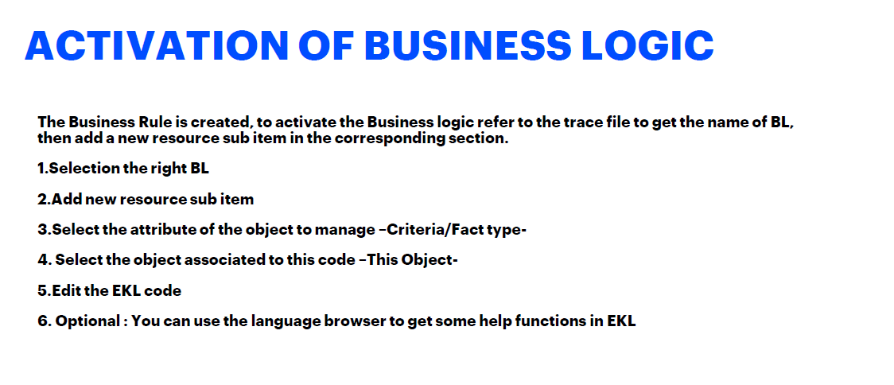

Slide 23
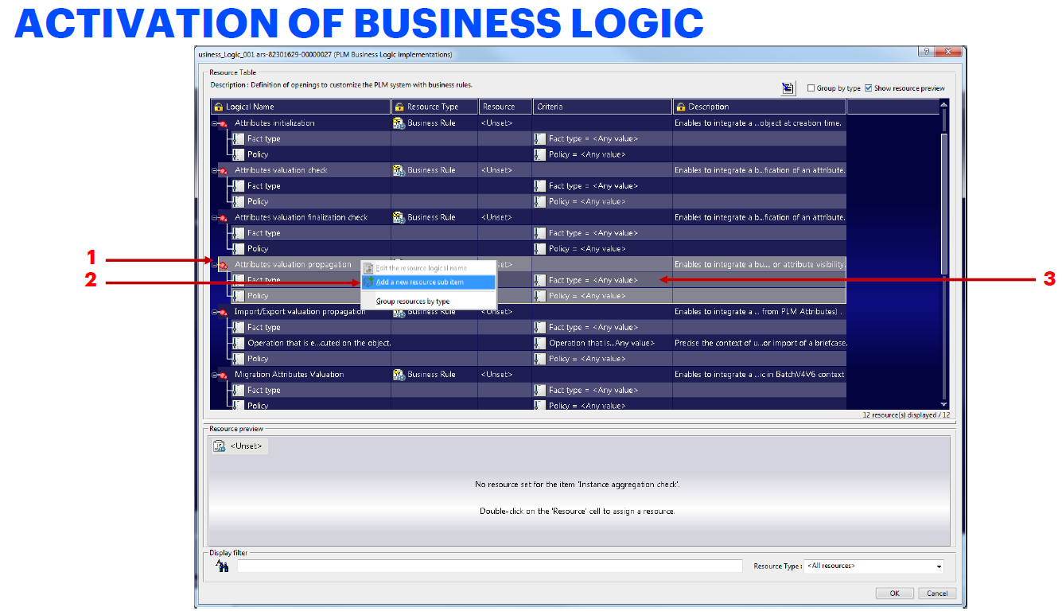

Slide 24
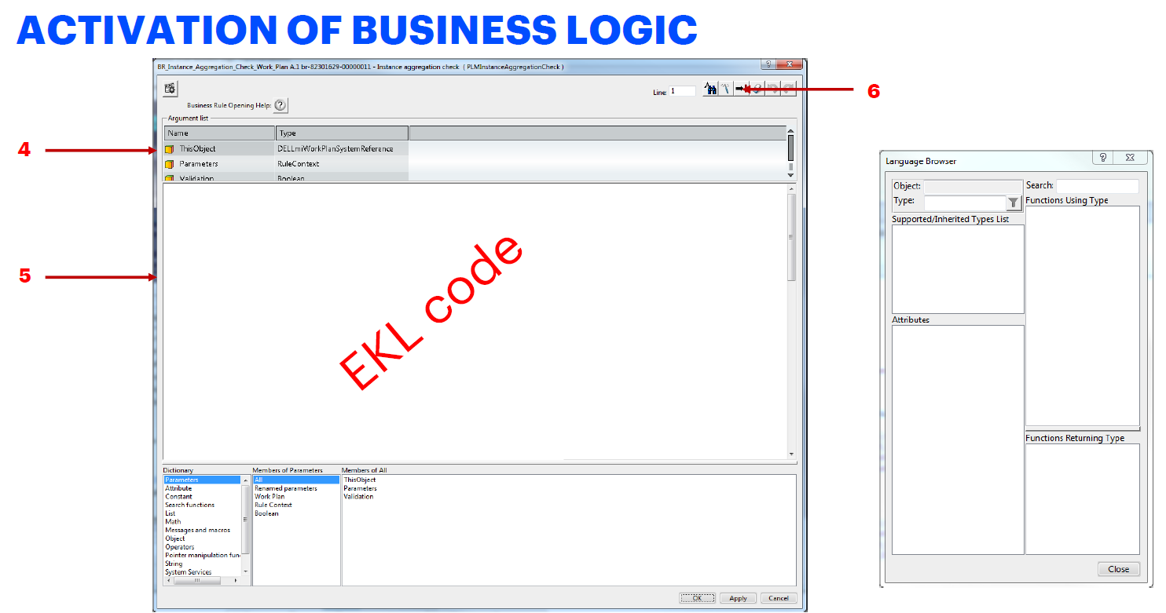

Slide 25
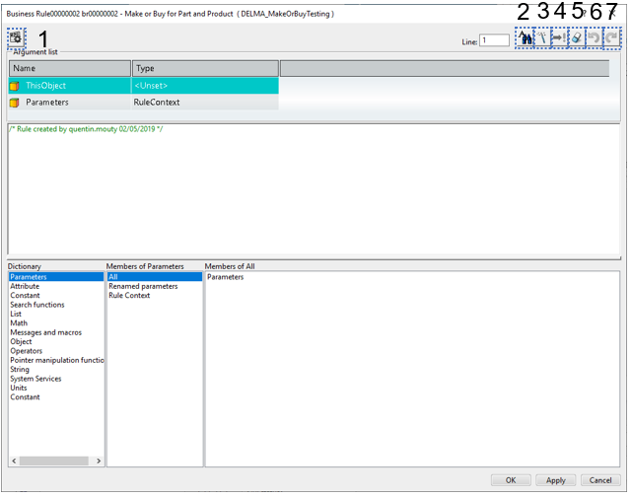
EKL Editor Overview
Settings
Find and replace
Language Browser
Check syntax
Language explore
Erase All
Undo
Redo

Slide 26
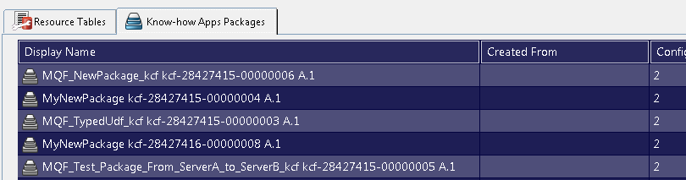
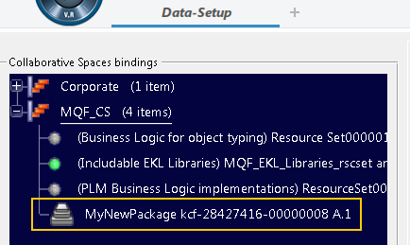
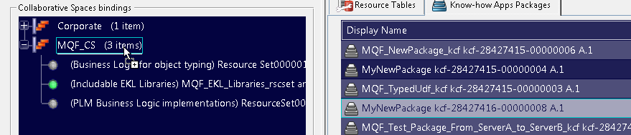

Binding the resource file in the Collabrative Space
In the Resource Table tab, locate the new package you created.
Drag and drop it onto the Collaborative Space you want it to be published to
Save
3
4

Slide 27
Know-how Apps Authoring Suite
Know-how Apps Authoring Suite is a series of apps allowing to define and manage custom applications (a.k.a. Know-how Apps).
The creation of custom applications can involve the use of the following apps that are part of the Know-how Apps Authoring Suite:
Know-how Apps Creation
Know-how Apps Components
Know-how Apps User Experience
Know-how Apps Resources
Know-how Apps Logic

